Slide 1

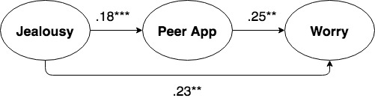
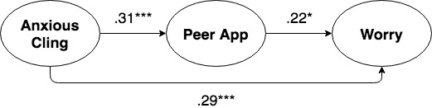
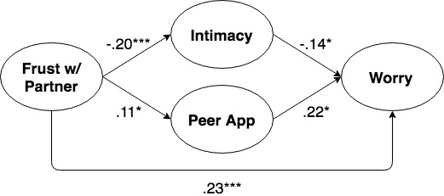
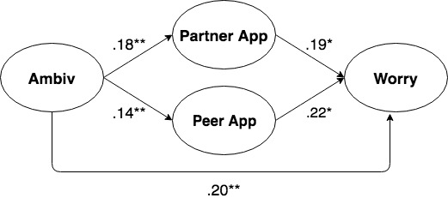
Attachment, Hookup Motives, and Situational Context as Predictors of Reactions to Hookups
Monica Schneider, Jennifer Katz, Erica Kane, Leslie Tetteh, Dinetra Gowdie, Gavin Raffloer, Yvette Williams
Department of Psychology, SUNY Geneseo
INTRODUCTION
Hookups are common among emerging adults, with multiple studies finding that approximately 80% of undergraduates report participating in at least one hookup in college (e.g., England, Shafer, & Fogarty, 2008; Garcia, Reiber, Massey, & Merriwether, 2012; Paul, McManus, & Hayes, 2000). Researchers have found that there are benefits and potential costs associated with hookups (cf., Hamilton & Armstrong, 2009).
Two factors potentially related to how women and men emotionally respond to hookups include attachment styles and motives for hooking up. According to Brennan & Shaver (1995), three attachment orientations (i.e., greater frustration with partners, more ambivalence, and less trust/confidence in others) are associated with both avoidants and anxious-ambivalents, with greater self-reliance and decreased proximity-seeking uniquely underlying avoidants and jealousy/fear of abandonment and anxious-clinging uniquely underlying anxious-ambivalents. Secures tend to be associated with greater trust/confidence in others, less frustration with partners, and greater proximity-seeking.
Previously, we found links between attachment orientations underlying secure, avoidant, and anxious styles and number of hookup partners, with hookup motives mediating this relationship (Schneider & Katz, 2017). Specifically, intimacy motives explained how proximity-seeking positively related to number of hookup partners, whereas enhancement motives explained how self-reliance negatively related to number of hookup partners.
Attachment and the degree to which a hookup satisfies an individual’s motives may predict emotional responses to hookups, depending on the situational context surrounding those experiences. We examined attachment orientations, hookup motives, and the situational context as predictors of students’ reactions to their most recent hookup.
METHODS
Participants
270 (206 women, 59 men) undergraduate students
Measures
Attachment Orientations (Brennan & Shaver, 1995)
Proximity Seeking (6 items [Alpha = .79])
Jealousy/Fear of Abandonment (6 items [Alpha = .80])
Anxious Clinging to Partners (6 items [Alpha = .69])
Frustration with Partner (6 items [Alpha = .88])
Ambivalence (5 items [Alpha = .76])
Trust/Confidence in others (6 items [Alpha = .81])
Self Reliance (6 items [Alpha = .83])
Hookup Motives Scale (Cooper, Shapiro, & Powers 1998)
Enhancement (5 items [Alpha = .83])
Intimacy (5 items [Alpha = .93])
Self Affirmation (5 items [Alpha = .88])
Coping (5 items [Alpha = .93])
Partner Approval (4 items [Alpha = .90])
Peer Approval (5 items [Alpha = .93])
Reactions to Most Recent Hookup (EHIS: Birnbaum & Laser-Brandt, 2002)
Relationship-Centered Outcomes (28 items [Alpha = .96])
Worry-Centered Outcomes (26 items [Alpha = .96])
Pleasure-Centered Outcomes (24 items [Alpha = .91])
RESULTS & DISCUSSION
Correlations Between Attachment Orientations, Hookup Motives, & Reactions to Most Recent Hookup
Correlations revealed that one attachment orientation underlying secure and anxious attachment (proximity-seeking) predicted relationship-centered outcomes. Attachment orientations associated with anxious (jealousy, anxious-clinging) and both types of insecure styles (frustration w/partner, ambivalence) predicted worry-centered reactions. No attachment orientations predicted pleasure-centered reactions (see Table 1).
Proximity-seeking was positively associated with intimacy motives; frustration with partner was negatively associated with intimacy motives. Moreover, orientations underlying anxious attachment (jealousy, anxious-clinging) and both insecure attachment styles (frustration w/partner, ambivalence) were positively associated with self-affirmation, coping, partner approval, and peer approval motives (see Table 2).
Hookup Motives as Mediators of Attachment Orientations and Reactions to Most Recent Hookup
OLS regressions and bootstrapping analyses revealed that intimacy motives mediated the relationship between proximity-seeking and relationship outcomes, suggesting that individuals high in proximity-seeking (secures, anxious- ambivalents) are more likely to experience positive relationship-centered reactions in their most recent hookup because they engage in hookups for intimacy (see Figure 1).
Peer approval partially mediated the relationship between attachment orientations that are uniquely associated with anxious attachment (jealousy, anxious-clinging), suggesting that individuals with anxious attachment styles may be at greater risk for negative hookup outcomes, in part, because of their concerns with others’ approval (see Figures 2 & 3).
Several hookup motives partially mediated the relationship between attachment orientations underlying both anxious and avoidant attachment styles (frustration w/partner, ambivalence) and worry-centered reactions (see Figures 4 & 5). These results suggest that individuals with certain insecure attachment orientations are at risk for negative emotional reactions to hookups, in part, because of the decreased intimacy and increased approval hookup motives associated with these orientations.
Overall Conclusions and Implications
Attachment orientations provide insight into college students’ reactions to hookups, with one attachment orientation associated with secures predicting positive outcomes, and several attachment orientations associated with anxious-ambivalents (in particular) and insecure attachment (in general) predicting negative outcomes. These relationships are partially explained by different hookup motives associated with different attachment orientations.
Consistent with our previous research linking proximity-seeking with number of hookup partners through intimacy hookup motives (Schneider & Katz, 2017), our results indicated that proximity-seeking also played an important role in relationship-centered outcomes through increased intimacy motives. Whereas self-reliance (which underlies avoidant attachment) was associated with fewer hookup partners in our previous research, it did not predict hookup reactions. Instead, attachment orientations associated with anxious and both insecure attachment styles predicted negative emotional hookup reactions.
Engaging in hookups may involve risks as well as benefits. The specific risks and benefits may vary as a function of each student’s attachment orientations and motives for hookups. Attachment orientations underlying both secure and insecure attachment styles were associated with students’ reactions to their most recent hookup experience. Thus, hookups do not necessarily reflect insecurity, dysfunction, psychopathology, or maladaptation. Rather, for many college students, casual sexual encounters may be a natural part of their sexual development (Snapp et al. 2015).
Healthy decisions about whether and how often to engage in hookups may vary for different individuals based on their unique psychological and emotional needs. Colleges and universities should incorporate honest, frank, nonjudgmental discussions about casual sex that avoid stigmatizing casual sexual encounters and instead emphasize responsible, healthy, empowered sexual decision making.
Table 1: Correlations Between Attachment Orientations, Hookup Motives & Reactions to Most Recent Hookup
Mediations
Figure 1
 | Relationship Centered | Worry Centered | Pleasure Centered
Attachment Orientations
Proximity Seeking | .22***
Jealousy |  | .29***
Anxious Clinging |  | .32***
Frustration with Partner |  | .35***
Ambivalence |  | .25***
Trust in Others
Self-Reliance
Sexual Motives
Enhancement | .17** | -.15* | .13*
Intimacy | .45*** | -.15* | .20***
Coping | .17** | .19** | .12*
Self-Affirmation | .19** |  | .16**
Partner Approval |  | .31***
Peer Approval |  | .31***
Figure 2
Figure 3
Figure 4
Table 2: Correlations Between Attachment Orientations and Hookup Motives
 | Enhancement | Intimacy | Self- Affirmation | Coping | Partner Approval | Peer Approval
Proximity Seeking |  | .25***
Jealousy |  |  | .29*** | .32*** | .36*** | .22***
Anxious Clinging |  |  | .29*** | .45*** | .43*** | .32***
Frustration with Partner |  | -.21*** | .20*** | .24*** | .26*** | .15*
Ambivalence |  |  | .19** | .25*** | .21*** | .18**
Self-Reliance
Trust in Others | -.17** | .12*
Figure 5

